Slide 1


micro:bit video tutorial
Lesson 9
micro:bit advanced lesson 9 “Ultrasonic sensor”
YahBoom micro:bit video tutorial

Slide 2
micro:bit robot entry tutorial
Content
Part1
Part 2
Part3
Part 4
Learning goals
Preparation
Search for blocks
Combine blocks
YahBoom micro:bit video tutorial

Slide 3
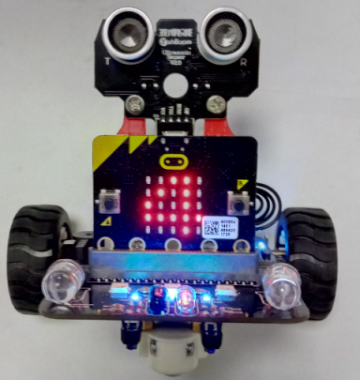
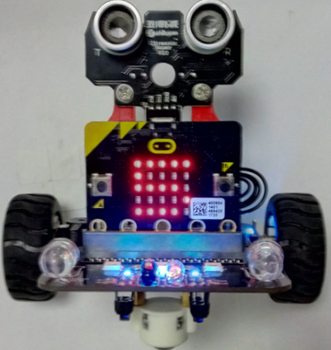
micro:bit video tutorial
Part 1
Learning goals
When you download the program, you can see the number on the dot matrix of the car, and if the hand is shielded in front of the ultrasonic, you can see that the number is turned into a digit. Ultrasound can measure the distance of 2-400 (CM). Let's have a look at the effect together.
YahBoom micro:bit video tutorial

Slide 4
micro:bit robot entry tutorial
Part 2
Hardware:
● 1 X USB cable
● 1 X micro:bit robot
Preparation
Then the micro:bit is connected to the computer through USB, and the computer will pop up a U disk and click the URL in the U disk to enter the programming interface. Input this URL https://github.com/lzty634158/yahboom_mbit_en to get the package.
YahBoom micro:bit video tutorial

Slide 5
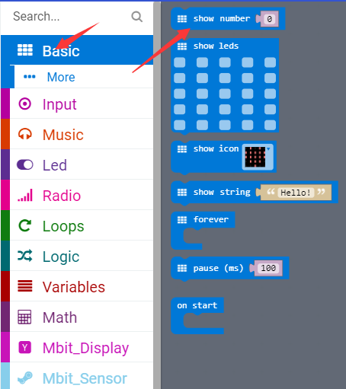
micro:bit video tutorial
Part 3
Search for blocks
YahBoom micro:bit video tutorial

Slide 6
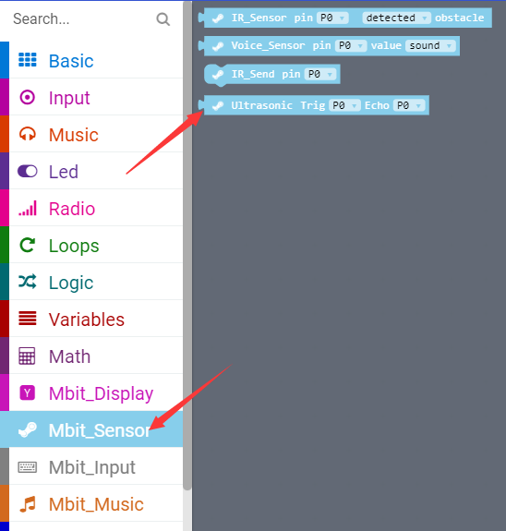
micro:bit video tutorial
Part 3
Search for blocks
YahBoom micro:bit video tutorial

Slide 7
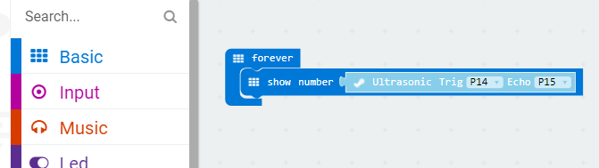
micro:bit video tutorial
Part 4
In this lesson, children should check their own ultrasonic connection. VCC corresponds to VCC and GND corresponds to GND. In addition, the demand for voltage is higher than that of ultrasonic. It is recommended to fill up the electric capacity and do the experiment again.
Combine blocks
YahBoom micro:bit video tutorial

Slide 8
micro:bit robot entry tutorial
robot
lesson
Thanks for watching！
Powered by YahBoom
YahBoom micro:bit video tutorial

